Slide 1

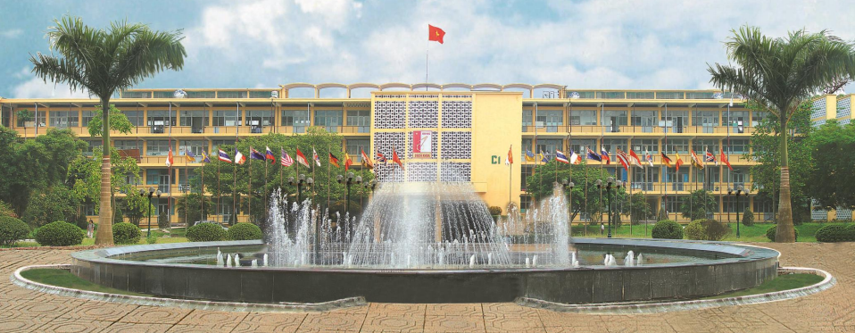
HANOI UNIVERSITY OF SCIENCE AND TECHNOLOGY
Chapter 3: organizing function
School of economics and management
PHD. Nguyen Thanh huong

Slide 2
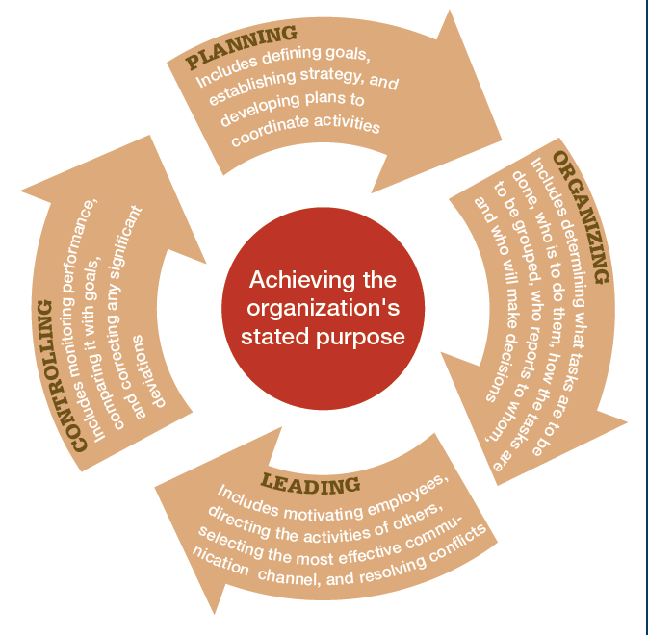
PROCESS OF MANAGEMENT

Slide 3
CONTENT
3.1.The Elements of Organizing
Designing Jobs
Job Specialization
Benefits and Limitations of Specialization
Alternatives to Specialization
3.2. Grouping Jobs: Departmentalization
Rationale for Departmentalization
Chain of Command
Narrow Versus Wide Spans
3.3. Distributing Authority
The Delegation Process
Decentralization and Centralization
3.4. Organizing HR
Concept & content of HR
Source of managerial staff

Slide 4

ORGANIZING CONCEPT
The function of organizing aims to establish a system of positions for each individual and department in such a way that individuals and departments can coordinate with each other effectively to achieve the organization's goals.

Slide 5

ORGANIZING CONCEPT
The function of organizing includes tasks related to identifying and dividing the work to be done, determining who or which groups will do what, who is responsible for which outcomes, how tasks will be coordinated, who will report to whom, and at which level or department decisions will be made.

Slide 6
CONTENT OF ORGANIZING FUNCTION
Managing Human Resource
Organizational Structure and Design

Slide 7
3.1. The Elements Organizing
Organizing
Deciding how to best group organizational activities and resources.
Organization Structure
The set of building blocks that can be used to configure an organization.

Slide 8
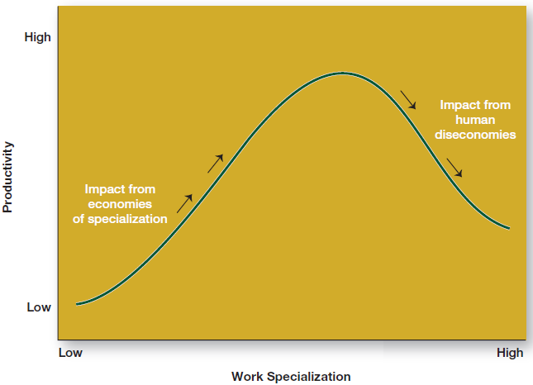
Specialization

Slide 9
Designing Jobs
Job Design
The determination of an individual’s work-related responsibilities.
Job Specialization (Division of Labor)
The degree to which the overall task of the organization is broken down and divided into smaller component parts.
Benefits of Specialization
Workers can become proficient at a task.
Transfer time between tasks is decreased.
Specialized equipment can be more easily developed.
Employee replacement becomes easier.
Limitations of Specialization
Employee boredom and dissatisfaction with mundane tasks.
Anticipated benefits do not always occur.

Slide 10
Adam Smith’s Example of Job Specialization
Making a pin (nail) requires 18 tasks
1 worker doing all 18 tasks might make
20 pins (nails) a day.
20 workers = (20 x 20) = 400 pins
______________________________
With specialization:
20 workers make 100,000 pins a day.
1 worker = 5,000 pins
20 pins vs. 5,000 pins per worker
Notes:
10

Slide 11
Alternatives to Specialization
Job Rotation
Job Enlargement
Job Enrichment

Slide 12
Job Rotation
It is the systematic transfer of employees from one job to another at regular intervals within the same organization. The jobs stay the same while the employees rotate through them.
This system can improve an employee's skills by training them in a variety of positions.
Employees might develop their multitasking abilities as they work on assignments for each department. Job rotation can relieve the monotony of performing the same duties every day.

Slide 13


Slide 14
Benefits
Develops diverse skills
Improves organizational understanding
Boosts creativity and learning spirit
Reduces boredom
Enhances satisfaction and engagement

Slide 15
Job Enlargement
Job enlargement is the combining of job tasks across the same level within a company.
This approach refers to an increase in an employee's number of tasks and is an alternative to job specialization where employees often focus on a limited amount of activities.
Implementing job enlargement widens the scope of individual team members to include more tasks and responsibilities.

Slide 16
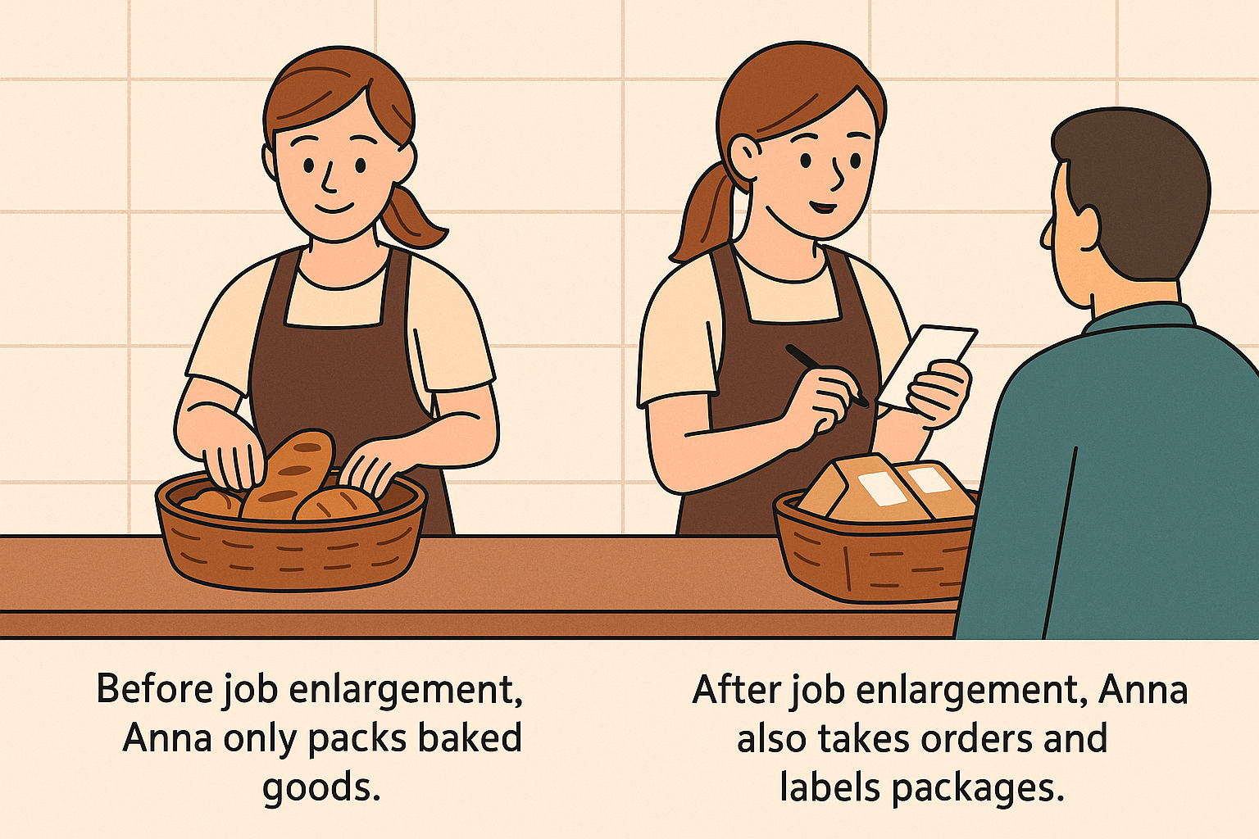

Slide 17
Benefits
Helps employees learn more skills and grow personally and professionally.
Ensures all tasks are completed and increases job satisfaction.
Gives employees the chance to earn more money.
Reduces boredom by avoiding repetitive tasks and supports career development.
Increases responsibility and decision-making power for employees.

Slide 18
Job Enrichment
It can be defined as a vertical restructuring of a job, i.e. integration of the tasks, role, responsibilities and authority across different levels in an organization, to add value to the employee’s existing job profile.

Slide 19


Slide 20
BENEFITS
Increases employee motivation by giving them more responsibilities.
Reduces repetitive work and helps minimize waste in the workplace.
Supports employees' career growth.
Gives employees more chances to make decisions, helping them develop leadership skills.
Improves job satisfaction and allows employees to use more skills, leading to higher-quality work.

Slide 21
3.2. Grouping Jobs: Departmentalization
Departmentalization
The process of grouping jobs according to some logical arrangement.
Rationale for Departmentalization
Organizational growth exceeds the owner-manager’s capacity to personally supervise all of the organization.
Additional managers are employed and assigned specific employees to supervise.

Slide 22
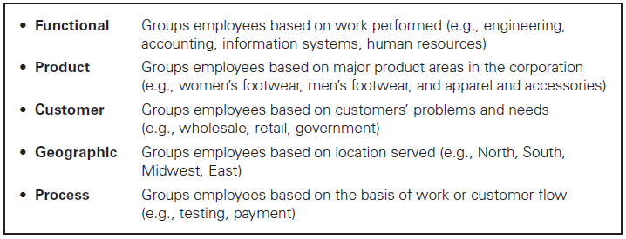
Departmentalization

Slide 23
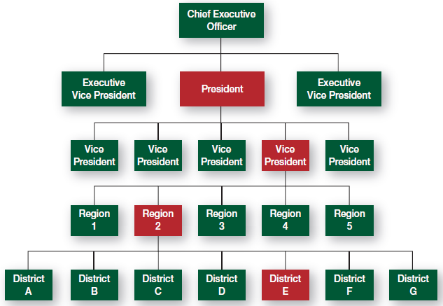
Types of Authority Relationships

Slide 24
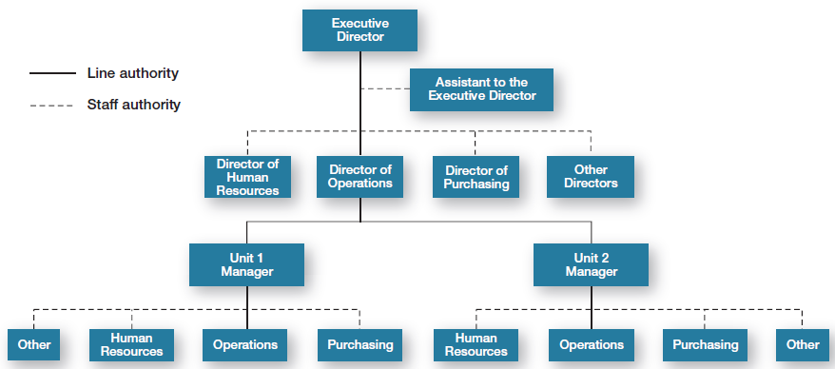
Line and Staff Authority

Slide 25
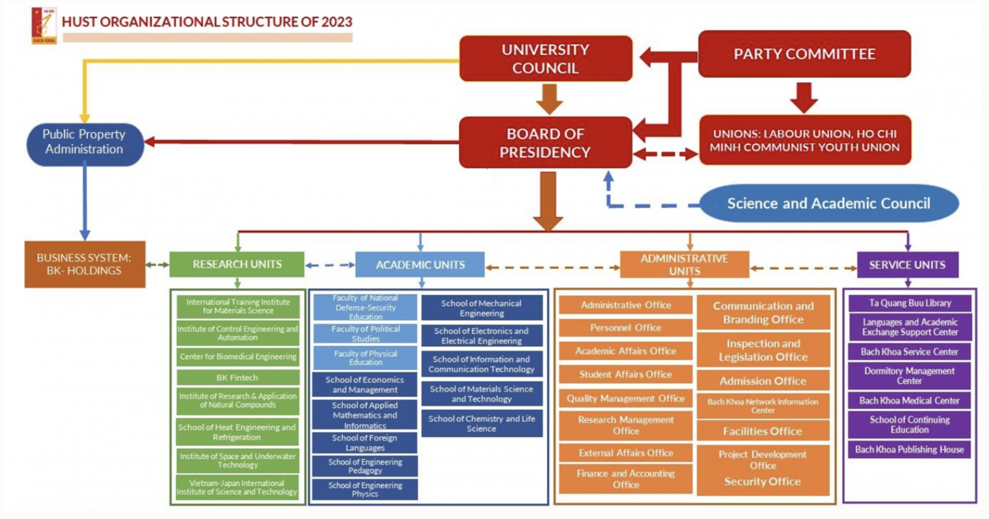
ORGANIZATIONAL STRUCTURE
Source: https://hust.edu.vn

Slide 26

Unity of Command
A structure in which each employee reports to only one manager

Slide 27
Establishing Reporting Relationships
Chain of Command
A clear and distinct line of authority among the positions in an organization.
Unity of Command
Each person within an organization must have a clear reporting relationship to one and only one boss.
Scalar Principle
A clear and unbroken line of authority must extend from the bottom to the top of the organization.

Slide 28
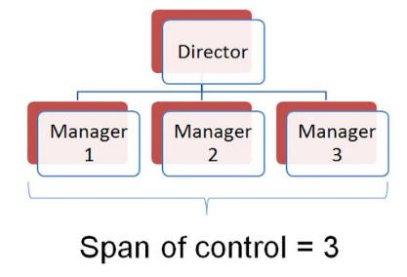
SPAN OF CONTROL
Span of Control: the number of employees or ranks of employees for which a manager is responsible

Slide 29
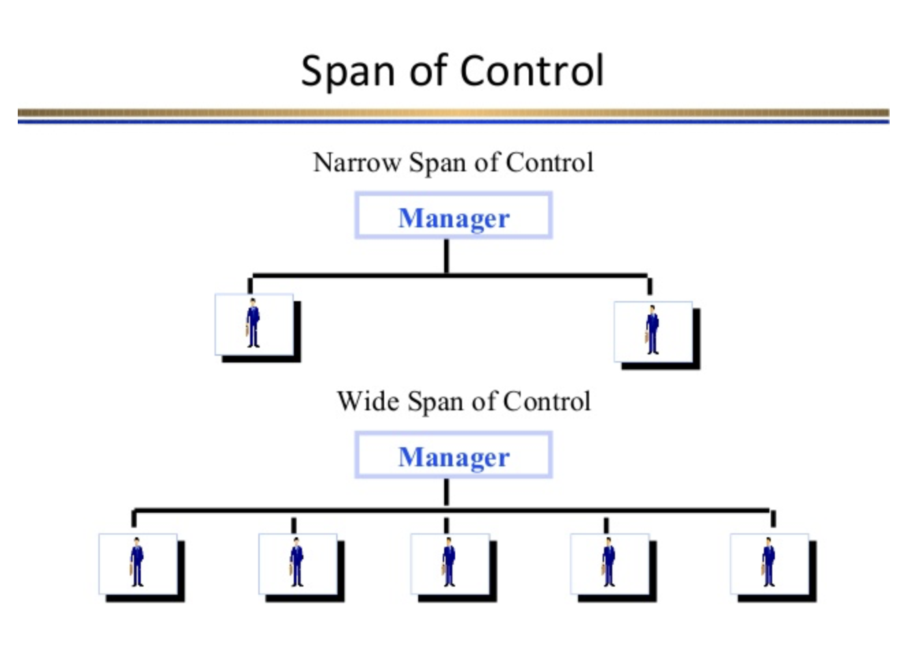

Slide 30
Tall Versus Flat Organizations
Tall Organization
President
Flat Organization
President
Figure 11.3

Slide 31
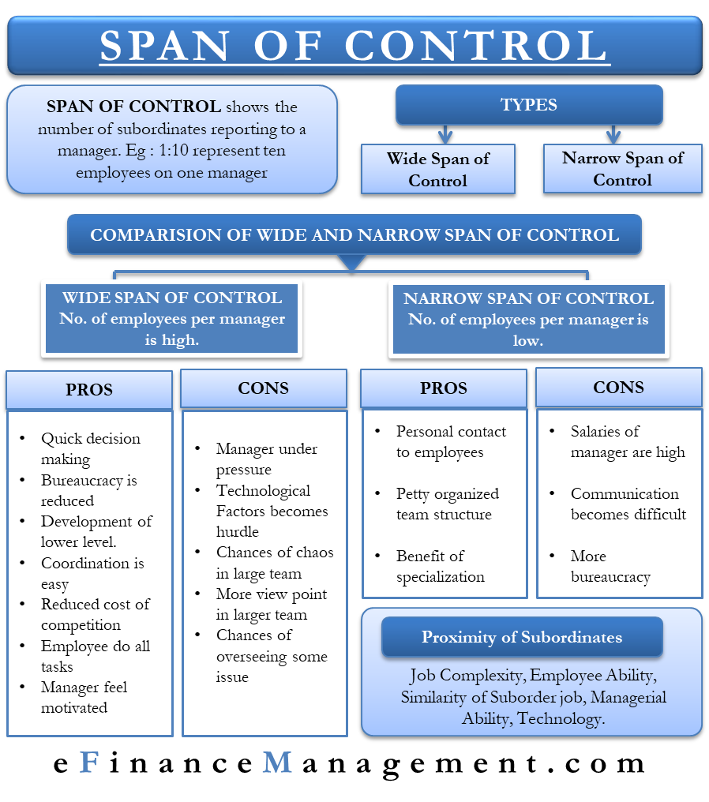

Slide 32
Span of Control
Effective and efficient span depends on:
Employee experience and training (more they have, larger span)
Similarity of employee tasks (more similarity, larger span)
Complexity of those tasks (more complex, smaller span)

Slide 33
Determining the Appropriate Span: Factors Influencing the Span of Management
Table 11.1

Slide 34
3.3. Distributing Authority
Authority
Power that has been legitimized by the organization.
Delegation
The process by which managers assign a portion of their total workload to others.
Reasons for Delegation
To enable the manager to get more work done by utilizing the skills and talents of subordinates.
To foster the development of subordinates by having them participate in decision making and problem solving that allows them to learn about overall operations and improve their managerial skills.

Slide 35
Steps in the Delegation Process
Step 1
Step 2
Step 3
Assigning responsibility
Granting authority
Creating accountability
Manager
Manager
Manager
Manager
Manager
Subordinate
Subordinate
Subordinate

Slide 36
Problems in Delegation
Manager
Reluctant to delegate.
Disorganization prevents planning work in advance.
Subordinate’s success threatens superior’s advancement.
Lack of trust in the subordinate to do well.
Subordinate
Reluctant to accept delegation for fear of failure.
Perceives no rewards for accepting additional responsibility.
Prefers to avoid any risk and responsibility.

Slide 37
Decentralization and Centralization
Decentralization
The process of systematically delegating power and authority throughout the organization to middle- and lower-level managers.
Centralization
The process of systematically retaining power and authority in the hands of higher-level managers.
Factors Determining the Choice of Centralization
The complexity and uncertainty of the external environment.
The history of the organization.
The nature (cost and risk) of the decisions to be made.

Slide 38

3.4. Human resource management
3.4.1. The nature and significance of human resource management
3.4.2. Identifying and selecting competent employees

Slide 39
3.4.1. The nature and significance of
human resource management
Concepts
Human resources (HR) are seen as the combination of physical and mental abilities of individuals.
The HRs of an organization encompass all the labor capabilities that the organization needs and can mobilize and utilize to accomplish both short-term and long-term tasks.
HRM involves activities aimed at enhancing the effective contributions of individuals to the organization's goals while also striving to achieve social and personal objectives.
Fuctions
Reinforce & maintain an adequate quantity and quality of labor to meet the demands and objectives of the enterprise.
Seek and develop the best methods and approaches for every employee to contribute maximally to the enterprise.
Create opportunities for individual development and self-affirmation.

Slide 40
3.4.1. The nature and significance of
human resource management
Human resource management (HRM) is the process of optimizing the organizational structure of a business through various activities such as recruitment, training, arrangement, utilization, evaluation, and promotion of individuals within each position of the management structure.
Significance: It is a crucial part of the management process, and if not done well, the management structure may struggle to function effectively
Effective implementation of this function lays the groundwork for efficiently using managerial staff at various levels and performing leadership or coordination functions in the future.

Slide 41
CONTENTS OF HRM
Preparing and receiving employees
Job analysis and design
Human resource planning
Recruitment
Organizing and effectively utilizing human resources
Assignment, management organization, labor compensation, improving labor conditions; evaluation, commendation, disciplinary actions
Workforce development
Training - retraining; position changes, job roles
Other activities
Providing information; labor unions and dispute resolution; welfare and profit sharing.

Slide 42
CONTENTS OF HRM
Demand for
Managerial staff
Analysis of
managerial staff Recruiting Utilizing
Source of
managerial staff
External
Promotion
Training
Internal

Slide 43
SOURCE OF MANAGERIAL STAFF
In order for the business management process to proceed continuously, it is necessary to also reserve and maintain a source of personnel that can be used as managerial staff for the enterprise.
This requires the development of strategies as well as policies on training managerial personnel

Slide 44
SOURCE OF MANAGERIAL STAFF
Internal source
The internal source ensures continuous management processes and reflects the managerial potential within the enterprise.
To maintain a good internal managerial workforce, managers use a human resource reserve chart, which is the organizational chart for each department of the enterprise. However, for each managerial position, specific criteria about the manager are noted, and by focusing on these criteria, senior managers can make the best decisions whenever there are changes in personnel structure.
External source
Recruiting students from universities.
Recruiting friends and relatives of employees.
Former employees of the enterprise.
Employees of competing firms.
Unemployed individuals or those seeking employment.
Freelancers

Slide 45
Identify the requirements
Identify the requirements
The selection of managerial personnel plays a crucial role in both delineation and overall management. Therefore, it needs to be conducted carefully and based on scientific principles. First of all, it is necessary to clearly define the requirements of the position that the organization is selecting.
Criteria:
Education level- Awareness - Skills - Relationship
Additionally, considerations may include:
The job should be challenging
The job should provide opportunities for individuals to be creative
Each job is associated with specific management skills.

Slide 46
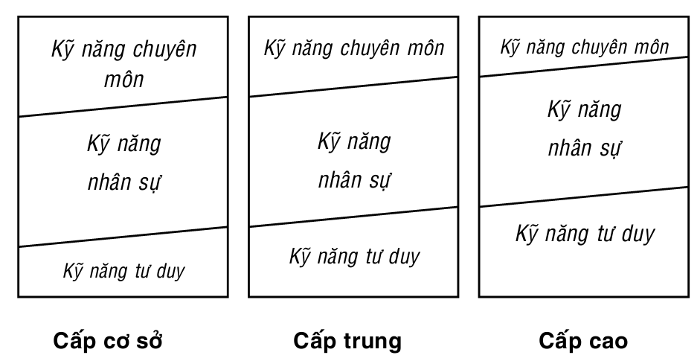
Managerial skills
Technical skills
Technical skills
Technical skills
Human
skills
Human
skills
Human
skills
Conceptual skills
Conceptual skills
Conceptual skills
First –line
Middle
Top

Slide 47

Human Resource Management

Slide 48

HANOI UNIVERSITY OF SCIENCE AND TECHNOLOGY

